Slide 1
Artificial Intelligence
Lei Yuxia
Department of science and technology
Qufu Normal University

Slide 2
Course literature
Nils J. Nilsson
Articifial Intelligence: A New Synthesis

Slide 3
About the textbook (i)
AI systems = 'agents'
a perspective to view AI topics
progression from simple ones to more complex ones
evolutionary AI approach
agents theme unifies many application topics of AI
expert systems, NLP, image processing, data mining, robotics, ...

Slide 4
About the textbook (ii)
Middle ground between theory and applications
rich in important AI ideas
some subjects considered in more detail
not a programming/implementation book
intuitive arguments & citations (not proofs)
basis for more advanced studies
makes literature accessible

Slide 5
About the textbook (iii)
Machine learning included
  neural nets, supervised learning, search heuristics, ...
No special chapters for bibliographic & historical remarks
  see Russell & Norvig -95 instead
Exercises (shouldn’t be too hard)

Slide 6
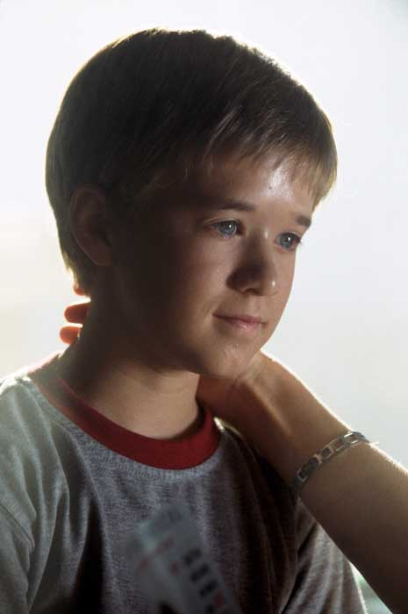
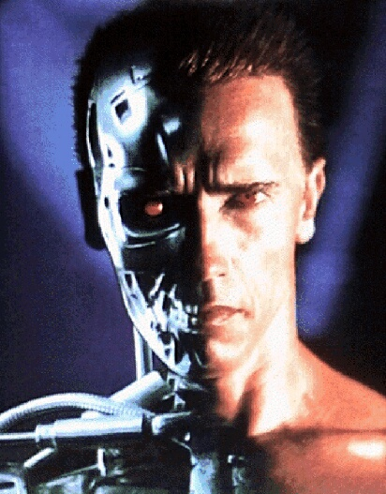
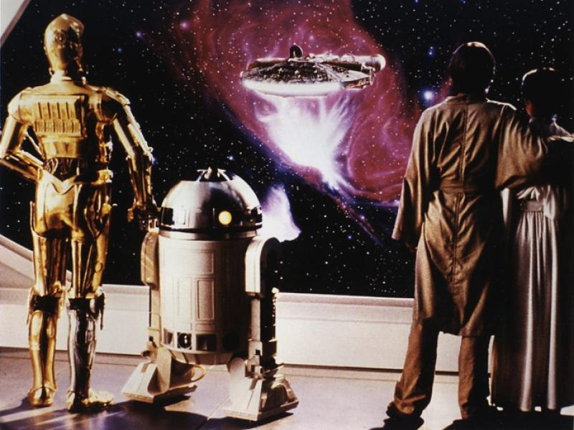
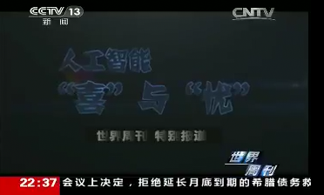
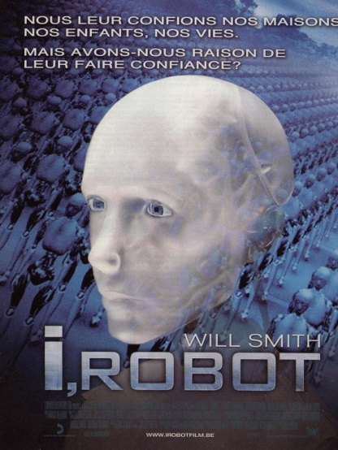
人工智能
引 言
《终结者》
《人工智能》
《星球大战》
《机械公敌》
8/28/2019
7

Slide 7
1 Introduction
Main topics
1. What is intelligence?
  2.What is human intelligence?
  3.What is AI?
  4. Goals of AI
  5. Can machines think?
  6. Foundations of AI
  7. Approaches to AI
  8. Contents of the book (and the course)
  9.Discussion

Slide 8
1. What is intelligence?
I believe that understanding intelligence involves understanding how knowledge is acquired, represented, and stored; how intelligence behavior is generated and learned; how motives, and emotions, and priorities are developed and used; how sensory signals are transformed into symbols; how symbols are manipulated to perform logic, to reason about the past, to plan for the future; and how the mechanisms of intelligence produce the phenomena of illusion, belief, hope, fear, and dreams—and yes even kindness and love.………….
--Nils J.Nilsson

Slide 9
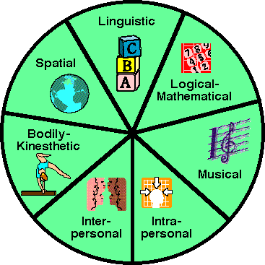
2.What is human intelligence?
Howard Gardner: The Seven Types of Intelligence

Slide 10
1.Linguistic:Children with this kind of intelligence enjoy writing, reading, telling stories or doing crossword puzzles.
2.Logical-Mathematical :Children with lots of logical inteligence are interested in patterns, categories and relationships. They are drawn to arithmetic problems, strategy games and experiments.
3.Bodily-kinesthetic:These kids process knowledge through bodily sensations. They are often athletic, dancers or good at crafts such as sewing or woodworking.
4. Spatial:These children think in images and pictures. They may be fascinated with mazes or jigsaw puzzles, or spend free time drawing, building with Legos or daydreaming.
5. Musical:Musical children are always singing or drumming to themselves. They are usually quite aware of sounds others may miss. These kids are often discriminating listeners.
6. Interpersonal:Children who are leaders among their peers, who are good at communicating and who seem to understand others' feelings and motives possess interpersonal intelligence.
7. Intrapersonal:These children may be shy. They are very aware of their own feelings and are self-motivated.

Slide 11
3. What is AI?
Definition one:
AI is the science and engineering of making intelligent machines, especially intelligent computer programs. It is related to the similar task of using computers to understand human intelligence, but AI does not have to confine itself to methods that are biologically observable.
--John McCarthy @ Stanford University

Slide 12
3.What is AI?
Definition two: AI, broadly defined, is concerned with intelligent behavior in artifacts. Intelligent behavior, in turn, involves perception, reasoning, communication, and acting in complex environments.
Intelligent behavior of artifacts
‘Intelligent behavior’ involves
  perception
  reasoning
  learning
  communicating
acting in a complex environment

Slide 13
4.Goals of AI
Engineering goal
  development of machines with intelligent behavior
  (at least) ‘as good as humans’
Scientific goal
  understanding intelligent behavior (wherever it occurs)
Book: engineering goal

Slide 14
5.Can machines think?
Turing 1950
  answer depends on what one means by the words machine and think
  Nilsson: also the word ‘can’ matters
What do we mean with ‘can’?
  someday or now?
  in principle or in practice?
  no examples of a thinking machine yet!

Slide 15
Why can’t it think?
Too complex to design and build
Analogy: global weather
  even if we knew ‘everything’ about weather
  this ‘everything’ not enough to to duplicate weather artificially
  we need as complex system as ‘weather’ itself
Can intelligence exist apart its embodiment (i.e. a human)?

Slide 16
What’s a machine?
Gears, steam, oil & steel?
Computers
Biological mechanisms
  Is a virus a machine?
  some bacteria genome have been sequenced completely (A,C,G,T)
    about 0.5 Mb of data
    task: given structure, predict functionality
    DNA sequence = blueprints of a machine?

Slide 17
Machines: made of what?
Searle -80
  only special (protein) machines can think
  → silicon machines can not
Newell & Simon -76
  Physical symbol system hypothesis
  PSS has all it takes for general intelligent action
  it doesn’t matter what PSS is made of as long as it can process symbols

Slide 18
Subsymbolic machines?
Material not important
Intelligence requires (subsymbolic) signal processing?
  humans: good in picture recognition
  explanation: images are treated as multidimensional signals
Neural computing

Slide 19
Other points of machines
Parallelism
  neurons in brain operate in parallel
  parallel computers required?
More expressive logic
  ‘fuzzy’ instead of binary logic
Animal neurons
  more complex than boolean switches
  artificial neurons required?

Slide 20
The Imitation Game
It is played with three people, a man (A), a woman (B), and an interrogator (C) who may be of either sex. The interrogator stays in a room apart from the other two. The object of the game for the interrogator is to determine which of the other two is the man and which is the woman. He knows them by labels X and Y, and at the end of the game he says either "X is A and Y is B" or "X is B and Y is A."

Slide 21
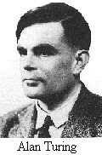
Alan Turing
Born: 23 June 1912 in London, England
Died: 7 June 1954 in Wilmslow, Cheshire, England

Slide 22
What is it to ‘think’?
Test instead of definition
Turing test
  Can interrogator C determine which of A and B is woman
  Replace A by a machine
  Will C decide wrongly as often?
  Can A think?
Simplified version: machine & C

Slide 23
Turing test
Designed to provide a satisfactory operational definition of intelligence
Intelligent behavior: ability to achieve human-level performance in all cognitive tasks
Human-level: sufficient level to fool an interrogator

Slide 24
What capabilities are required from a computer to pass Turing's test?
Natural language processing for communication
Knowledge representation to store information
Automated reasoning to exploit the stored information
Machine learning to adapt to new circumstances, detect and extrapolate patterns
Physical simulation is not required, since it is not necessary for intelligence

Slide 25
6.Foundations of AI
Although AI is young, it has inherited many ideas, techniques and viewpoints from other disciplines
Philosophy: theories of reasoning and learning, viewpoint: mind is constituted by the operation of a physical system
Mathematics: formal theories of logic, probability, decision making, computation
Psychology: tools to investigate human mind, scientific vocabulary to express theories about it
Linguistics: theories of the structure and meaning of human language
Computer science: tools to make AI a reality

Slide 26
7. Approaches to AI
Human-level intelligence is still distant
What are the best approaches?
  give foundation for long-term research or
  give short-term results
  perhaps a combination is required
Existing paradigms can be (coarsely) grouped to
  symbol-processing approaches (GOFAI)
  subsymbolic approaces

Slide 27
Symbol-processing approaches
Accept the PSS hypothesis
Knowledge-based approach
  (declarative) knowledge bases
  apply logical operators to KB to deduce consequences
Most approaches are of T-D -nature
  knowledge level (what knowledge is required)
  symbol level (how to represent it)
  implementation (how to manipulate it)

Slide 28
Subsymbolic approaches
Bottom-up (B-U) style
  we have to follow the evolution of human
  start from signals & signal-processing capabilities of simple animals
  even these can often be useful
  higher creatures build on these
Emphasizes symbol grounding
  interaction of machine & environment
    input signals → symbols
    symbolic actions → effects in environment
  emergent behavior: function of both machine & environment

Slide 29
8. Contents of the book
Evolving series of agents
  describe ideas and techniques to mechanize intelligence
working in an artificial world
  `toy environment’ (grid space) for simplicity
  real world is often too complex to illustrate the very concept

Slide 30
Grid-space world
Discrete 3-dimensional grid space
  2-dimensional grid of cells as floor
  sufficiently rich to demand intelligence
  cells may contain objects
  space may have walls
Agents
  move on the floor
  sense the environment
  perform actions on objects

Slide 31
Grid-space world (ii)
Customizable to many other toy-worlds existing in AI literature
Many AI techniques are discrete
  countable (often finite) # of locations, time points, agents, objects
Connection to continuous world requires subsymbolic processing

Slide 32
Agent evolution (i)
Reactive agents: senses & actions
  with or without memory
  action = function of senses & past
Agents with ‘model of the world’
  simulate world & actions on it
  iconic systems (complete, e.g. chess)
  feature based systems (incomplete)
    declarative description of ‘what is known’

Slide 33
Agent evolution (ii)
Planning agents
  plan = series of actions with effects
  take actions leading toward some goal
  can work in worlds that cannot be perfectly sensed and modeled (must track consequences of actions)
Reasoning agents
  ’if A is at X it can not be at Y’
  can deal with constraints on world
  can deduce new information from the constraints

Slide 34
Agent evolution (iii)
Worlds with many agents
  influence on other agents
  new action: communication
Learning agents
  part of all evolutionary steps
  autonomous systems: no built-in knowledge
  behaviour = f(senses, past experience)
  halfway: initial but modifiable KB

Slide 35
9. Discussion
Animal & human behavior has inspired both B-U & T-D directions
Bottom-up
  behavior is a result of combining ‘neuronlike’ computational elements
  models for animal behavior, human perception, ...
  signal recognition (speech, OCR)
Top-down
  focus on things that have a symbolic model
  problem-solving, language

Slide 36
Does T-D/B-U matter?
Recall: engineering goal
We do not have to duplicate everything
AI machines may differ from humans
  birds vs. aeroplanes
  `natural’ intelligence vs. AI
    brute-force machines
    different thinking methods
  is it possible to duplicate human behavior with computers (i.e. are there some architectural restrictions)?

Slide 37
Intelligent behavior
Animals: just economic agents?
  utility theory, economics
Independent of computation?
  is right answer enough or
  does the method have to be intelligent, too?
Right system instead of `right thing’?
  Impossible to do always the ‘right thing’
  bounded rationality
    computational actions (and decisions) to estimate
    which real world action is best

Slide 38
Computational concerns
Many AI problems are HARD
  intractable in computational sense
  AI: worst case does not matter
  good average-case performance
  approximate solutions
  heuristics

Slide 39
What if AI succeeds?
Cheap robots, NLP, ES, …
  economic effects
  unemployment or more jobs?
  new jobs but AI can handle them too?
Are all tasks appropriate?
  teaching, judging, …
  illusion of intelligence possible
  also: not using when should

Slide 40
AI and understanding of ourselves
Astronomy
  earth is center of everything →
  earth is just a rock in space
Evolutionists
  human being is ’king of the world’ →
  human being is just a link in a chain of DNA-based life forms
In general
  changes of perspective
  difficult to accept when invented

Slide 41
AI resources
Journals
  Artificial Intelligence
  Journal of AI Research (JAIR)
  Computational Intelligence
  J. of Experimental and Theoretical AI
Conferences & organizations
  AAAI, IJCAI, ECAI
  ACM SIGART

Slide 42
AI resources (cont)
Summaries found in
  Encyclopedia of AI (Shapiro -92)
  Handbook of AI (4 vol set)
Textbooks
  Russell & Norvig –95 (AIMA)
  Ginsberg -93
  Winston -92
  Rich & Knight -91

Slide 43
10.KR and reasoning
Propositional Calculus
Resolution in Propositional Calculus
Predicate Calculus
Resolution in Predicate Calculus
Knowledge-Based Systems
Representing Commonsense Knowledge

Slide 44
reference
Timo Knuutila
Department of Information Technology
University of Turku

Slide 45
人工智能
电子资源
研究纵览
http://www-2.cs.cmu.edu/Groups/AI/html/faqs/top.html
http://spinoza.tau.ac.il/hci/dep/philos/ai/links.html
http://www-formal.stanford.edu/jmc/whatisai/whatisai.html
http://psych.utoronto.ca/%7Ereingold/courses/ai/
http://www.csc.liv.ac.uk/~frans/OldLectures/2CS24/ai.html
研究专刊
http://www.jair.org/
公共测试平台
http://www.abelard.org/turing/tur-hi.htm
各类研究
http://www.aaai.org/Pathfinder/pathfinder.htmlhttp://www.cs.berkeley.edu/~russell/ai.html
http://ai.iit.nrc.ca/ai_point.htmlhttp://www.compinfo-center.com/tpai-t.htm
http://www.cs.cmu.edu/afs/cs.cmu.edu/project/ai-repository/ai/html/other/repositories.html
编程代码
http://www.cs.berkeley.edu/~russell/prog.html
研究组织
http://www.aaai.org/http://www.ai.mit.edu/http://sound.media.mit.edu
http://ai.iit.nrc.cahttp://www.aic.nrl.navy.milhttp://ic-www.arc.nasa.gov/ic
http://www.iiia.csic.eshttp://www.fingerpass.nethttp://www.holotopology.com

